Slide 1
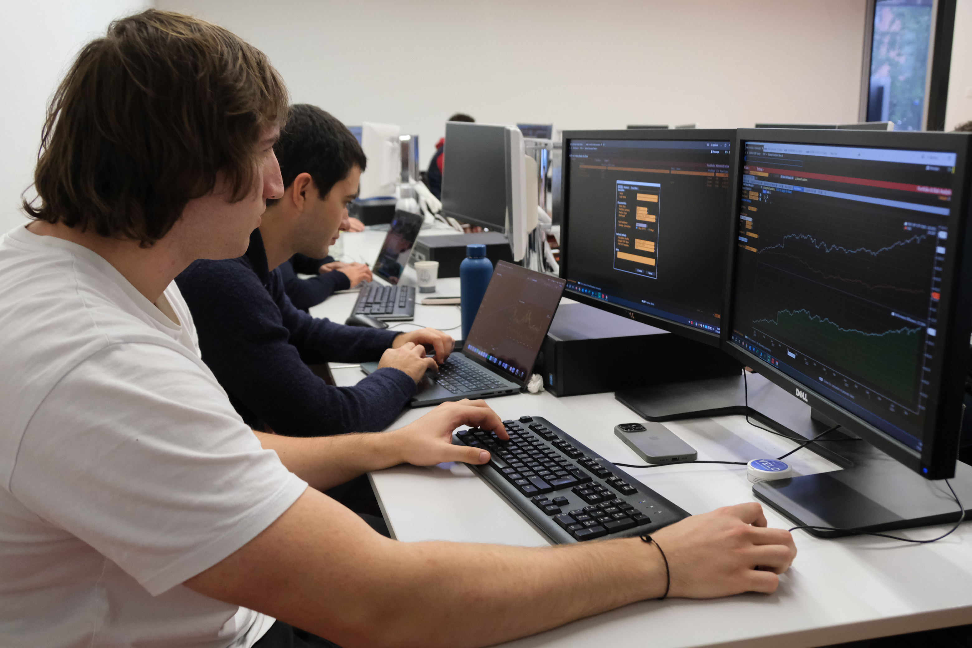

AURORA
CAPITAL MANAGEMENT
AMC Round 1 - Group 7
HTTPS://AURORACAPM.CH

Slide 2
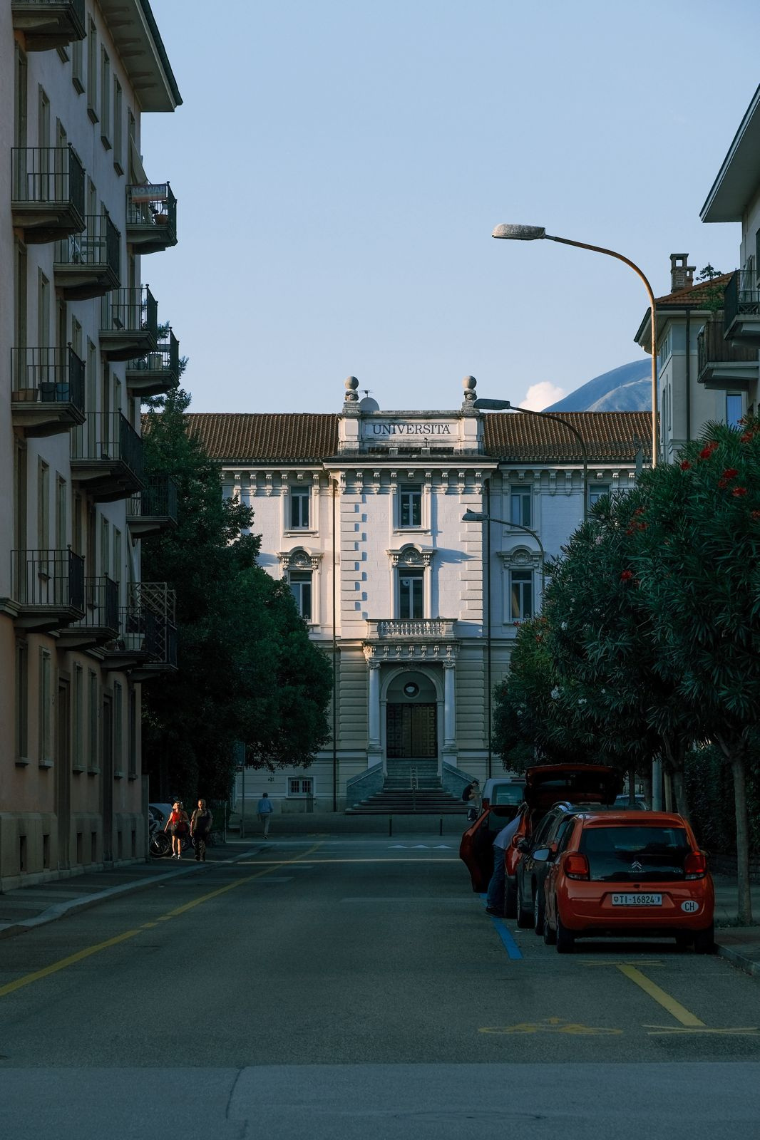
AURORA CAPITAL MANAGEMENT
OUR COMPANY
Founded in October 2024 in Lugano, Switzerland, Aurora Capital Management is a dynamic and forward-looking asset management firm.
The company represents the combined vision and expertise of five accomplished students from the Università della Svizzera Italiana (USI), united by a shared passion for finance, technology, and innovation.
With a fresh approach to digital finance and fintech, Aurora Capital Management is poised to make a significant impact in the evolving landscape of asset management.
HTTPS://AURORACAPM.CH

Slide 3
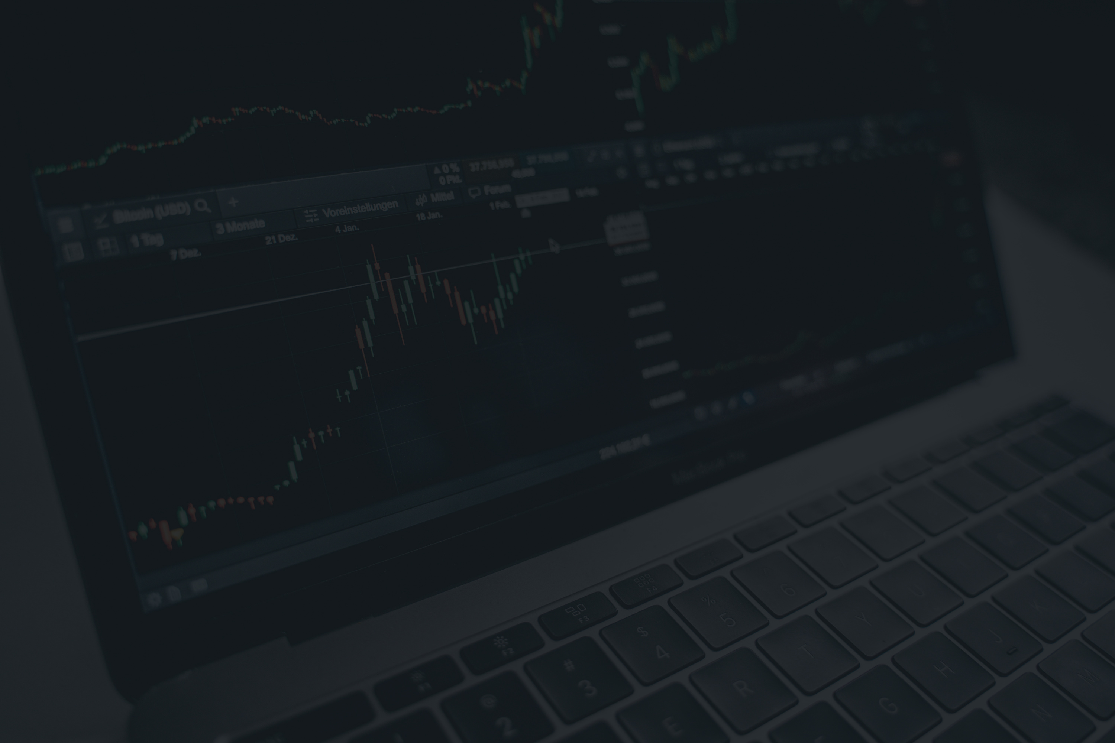
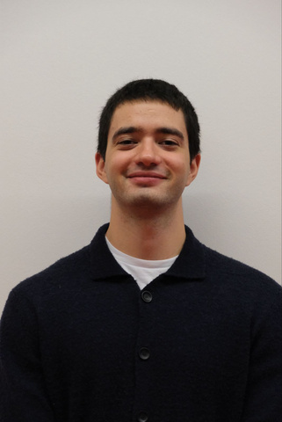
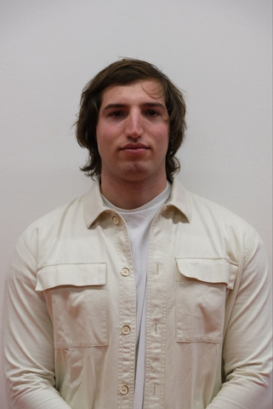



MEET OUR TEAM
NICOLA FOCHI
ALESSANDRO ZANICHELLI
LEONARDO
DI GENNARO
LU YI
SARA ELVEBAKK
PORTFOLIO MANAGER
QUANTITATIVE ANALYST
RISK ANALYST
DATA ENGINEER
SOFTWARE DEVELOPER

Slide 4
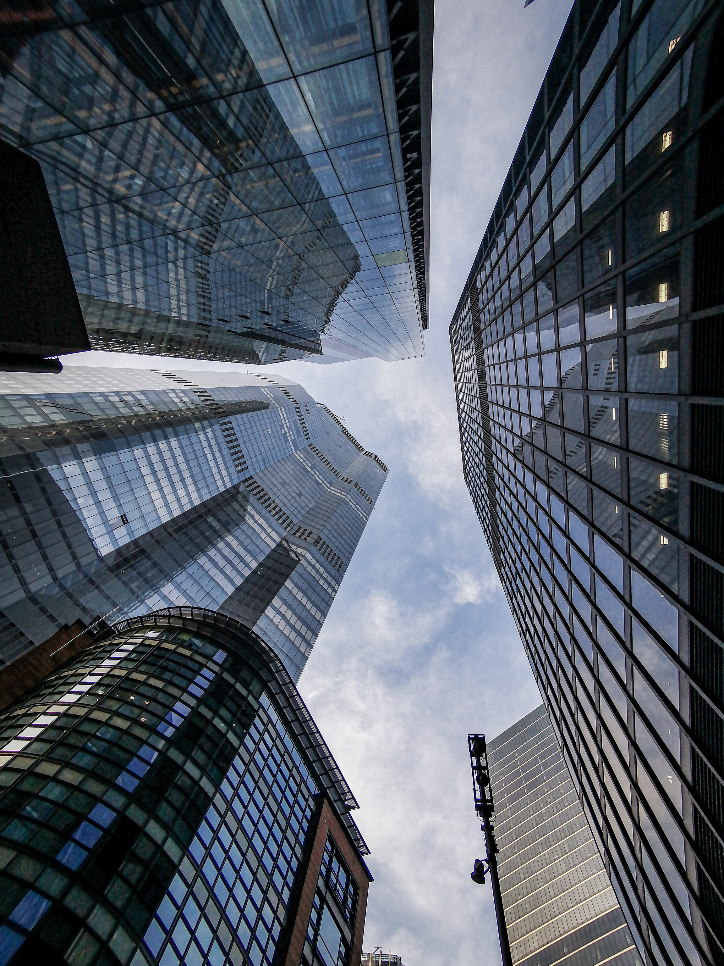
AURORA CAPITAL MANAGEMENT
VISION
To be a leading asset management firm, delivering innovative and competitive investment solutions with a focus on integrity, transparency, and performance.
MISSION
We implement a disciplined investment strategy focused on transparency, accountability, and risk management. By tracking performance and maximizing the Information ratio, we balance returns and risk. Global diversification helps reduce uncertainty and support long-term growth for our clients.
HTTPS://AURORACAPM.CH

Slide 5

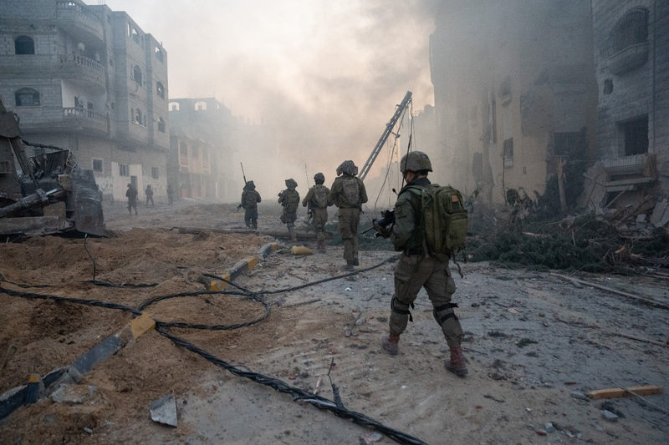
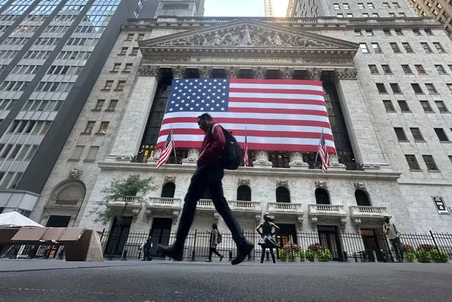
MARKET OUTLOOK
AURORA CAPITAL MANAGEMENT
HTTPS://AURORACAPM.CH
INFLATION
GEOPOLITCAL TENSIONS
US ECONOMY
The US economy shows strength despite global challenges. Supported by robust consumer spending and investments in manufacturing, the economy remains resilient. Anticipated interest rate cuts by the Federal Reserve in late 2024 may further boost growth. Strategic investment in key sectors poised for recovery and innovation can help investors capitalize on emerging opportunities.
Inflation remains a key concern in 2024 due to ongoing supply chain disruptions and surging commodity prices, especially in oil. The Ukraine-Russia war, alongside Middle East tensions, has exacerbated these challenges. Interest rate cuts are likely, however central banks may maintain tight policies if inflation persists, which could slow global economic growth.
Geopolitical risks, particularly conflicts in Ukraine, the Middle East, and other regions, continue to disrupt markets and fuel volatility. These conflicts affect critical sectors like energy and agriculture, raising concerns about global stability. Investors should focus on diversifying across regions and sectors to mitigate these risks and safeguard portfolio performance.

Slide 6

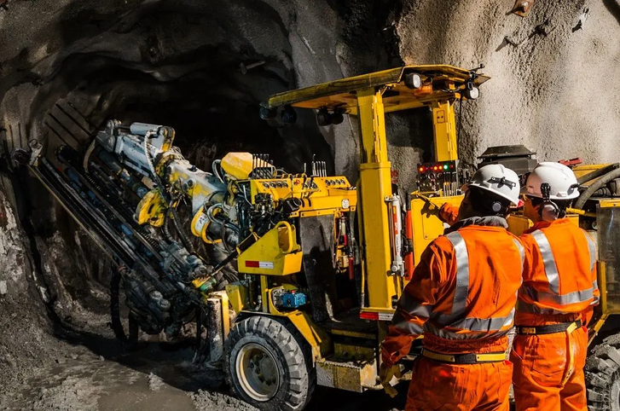
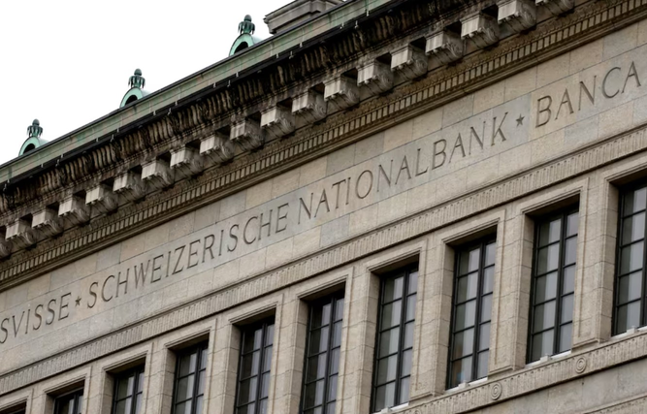
SECTOR
AURORA CAPITAL MANAGEMENT
HTTPS://AURORACAPM.CH
TECHNOLOGY
BASIC MATERIALS
FINANCIAL SERVICES
We chose the technology sector due to its strong growth outlook, driven by increasing demand for innovation in AI, cloud computing, and cybersecurity. As businesses and consumers continue to embrace digital transformation, companies in this sector are expected to benefit from sustained revenue growth and global expansion, making it a key driver of future portfolio returns.
The basic materials sector was selected for its ability to provide stability during inflationary periods and economic expansions. Rising global demand for infrastructure development and industrial production will likely boost the need for raw materials like metals and chemicals. This sector also offers a hedge against inflation, as prices of materials typically rise with economic growth.
We focused on financial services because of its central role in providing liquidity and capital to the broader economy. With interest rates stabilizing and economic growth rebounding, banks, insurers, and asset managers are well-positioned to benefit from increased lending, investment, and financial activity. This sector offers both income potential and resilience, making it a strong choice for long-term stability.

Slide 7
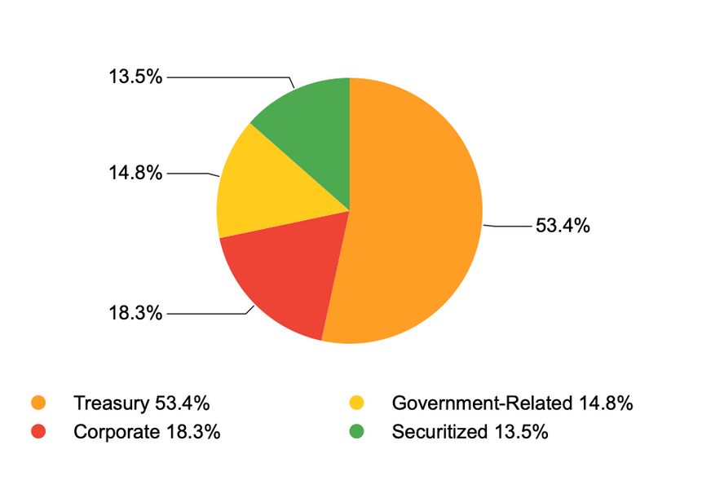
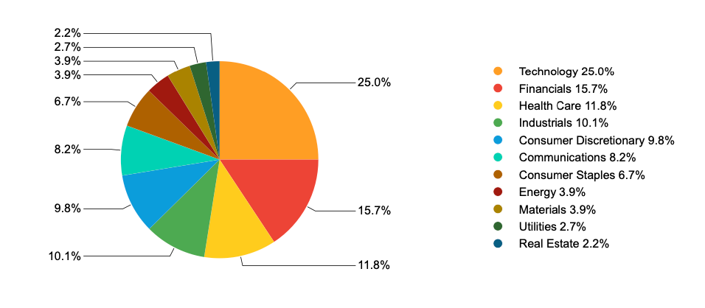
BENCHMARK
AURORA CAPITAL MANAGEMENT
HTTPS://AURORACAPM.CH
Bloomberg Global EQ:FI 60:40 Index
Designed to measure cross-asset market perfomance globally.
The index is composed by 60% equities and 40% fixed income. Specifically by Bloomberg Developed Markets Large & Mid Cap Total Return Index (DMTR) and Bloomberg Global Aggregate Index (LEGATRUU) respectively.
LEGATRUU COMPOSITION
DMTR COMPOSITION

Slide 8
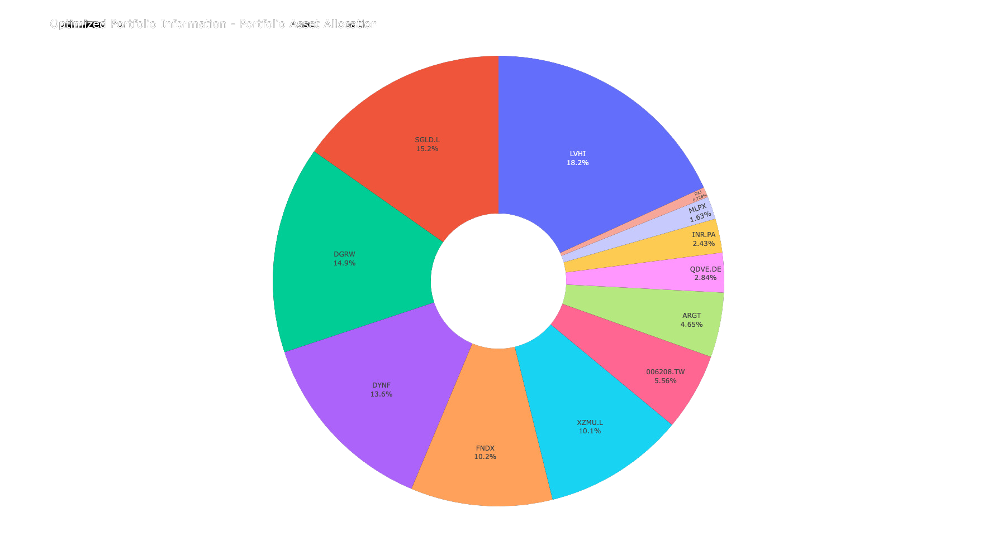
AURORA CAPITAL MANAGEMENT
Portfolio Composition (by ETF)
STRATEGY
The portfolio emphasizes income stability and risk mitigation. LVHI, the largest holding, targets high-dividend, low-volatility stocks, while SGLD provides gold exposure to hedge against inflation and downturns. Together, these assets aim to reduce risk and ensure steady returns even in volatile markets.
Growth is pursued through DGRW’s focus on U.S. dividend-growth stocks and DYNF’s multi-factor equity strategy. FNDF and XZMU.L add international and ESG-focused exposure, combining value-oriented and sustainable investments to support long-term growth and responsible investing.
HTTPS://AURORACAPM.CH

Slide 9
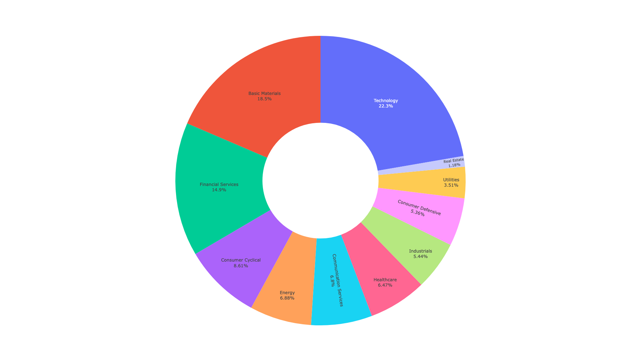
AURORA CAPITAL MANAGEMENT
Portfolio Composition (by Sector)
SECTOR ANALYSIS
Our portfolio is led by Technology at 22.3%, reflecting strong performance driven by innovation and digital demand.
Basic Materials and Financial Services follow with 18.5% and 14.9%, providing stability through essential commodities and financial institutions.
Consumer Cyclical (8.61%) and Energy (6.88%) help capture growth during expansions while managing volatility.
Defensive sectors like Healthcare (6.47%) and Consumer Defensive (5.36%) add resilience, while Real Estate (1.18%) offers diversification through tangible assets.
HTTPS://AURORACAPM.CH

Slide 10
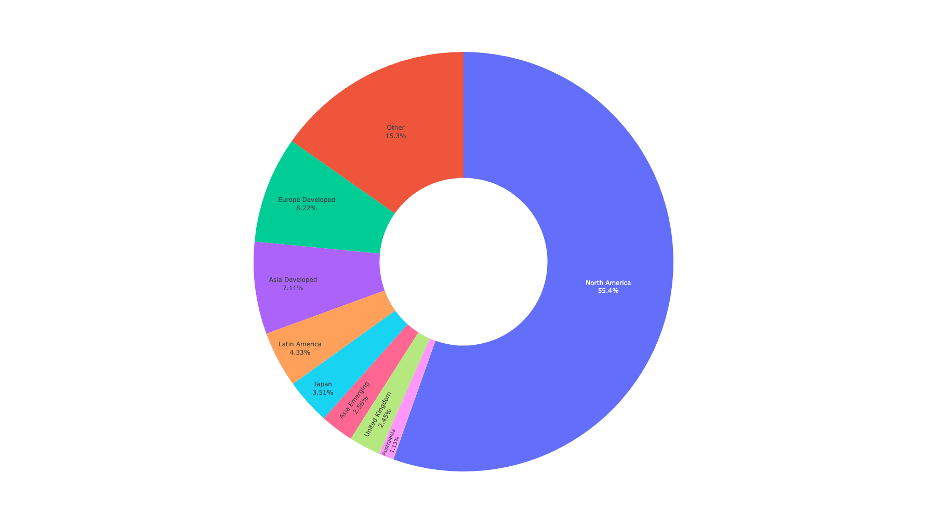
AURORA CAPITAL MANAGEMENT
Portfolio Composition (by Geo-Area)
GEOGRAPHICAL COMPOSITION
The geographical composition showcase a dominant exposure to North America (55.4%) highlights the continued dominance of the USA in the global economy.
The allocation across other regions allows us to capitalize on growth opportunities in both developed and emerging markets.
For instance, Europe Developed follows at 8.22%, providing stability from their developed markets while Asia Developed and Japan contribute a combined 6.28%, reflecting growth in technology and manufacturing. Finally, Latin America (4.33%) and Asia Emerging (2.56%) add exposure to fast-growing emerging markets, while other regions and smaller allocations spread risk further.
.
HTTPS://AURORACAPM.CH

Slide 11
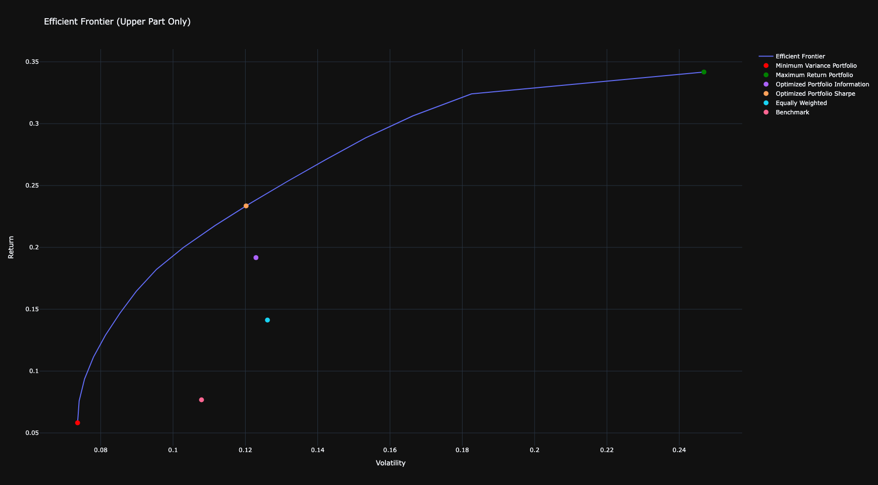
BACKTESTING
AURORA CAPITAL MANAGEMENT
Efficient Frontier
The efficient frontier illustrates the trade-off between return and volatility, guiding portfolio optimization by showing the most efficient asset allocations. Our portfolios are plotted along this frontier to compare their risk-return performance against benchmarks.
The minimum variance portfolio, at the far left, shows the lowest risk but also modest returns. On the right, the maximum return portfolio yields the highest returns, though with higher volatility.
Our optimized portfolios, using the Information and Sharpe ratios, are near the efficient frontier, balancing risk and return effectively. The Information-optimized portfolio delivered higher returns for its level of risk, outperforming others. In contrast, the equally weighted portfolio, which lacks risk-return optimization, fell below the frontier, showing less efficiency. Obviouslly the Sharpe Optimized lies on the efficient frontier.
The benchmark portfolio, with moderate return and volatility, underperformed compared to the optimized strategies. This analysis shows how optimization enhances long-term returns while managing risk, outperforming simpler allocation methods.
Sharpe Optimized
Information Optimized
Equally Weighted
Benchmark
Minimum Variance
HTTPS://AURORACAPM.CH

Slide 12
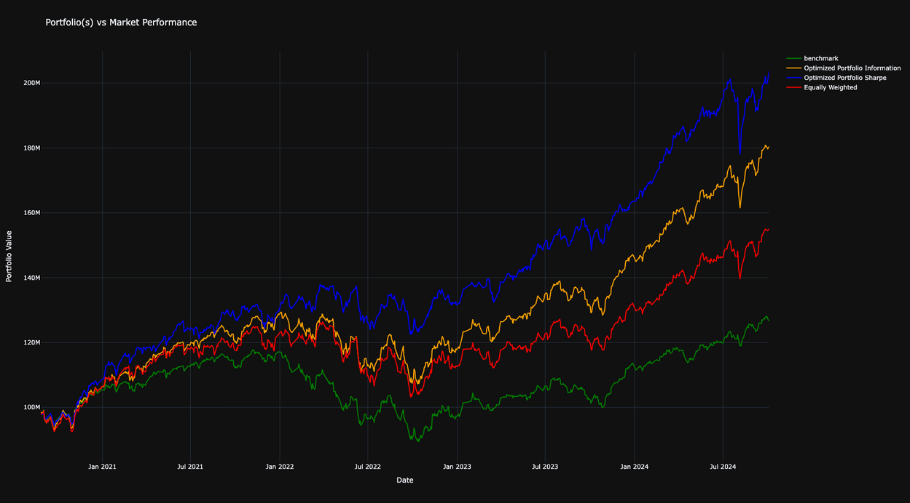
BACKTESTING
AURORA CAPITAL MANAGEMENT
Portfolio Returns
We compared our portfolio strategies against the BMA6040 benchmark, which showed moderate growth over time. This serves as a baseline for evaluating our optimized portfolios.
The Sharpe-optimized portfolio (blue line) delivered the highest cumulative return, demonstrating superior long-term performance. This strategy effectively balances excess return with tracking error, maximizing returns relative to risk.
The Information-optimized portfolio (yellow line) also performed well, offering a strong risk-adjusted return, though slightly lower than the Sharpe Ratio portfolio.
In contrast, the Equally weighted portfolio (red line) provided solid but lower returns than the optimized strategies, showing that while equal-weighting is straightforward, it is less efficient than more targeted approaches.
Both optimized portfolios outperformed the benchmark and equally weighted portfolio, highlighting the importance of strategic optimization for enhancing returns over time.
Shar. Opt.
Inf. Opt.
Eq. Weighted
Benchmark
HTTPS://AURORACAPM.CH

Slide 13
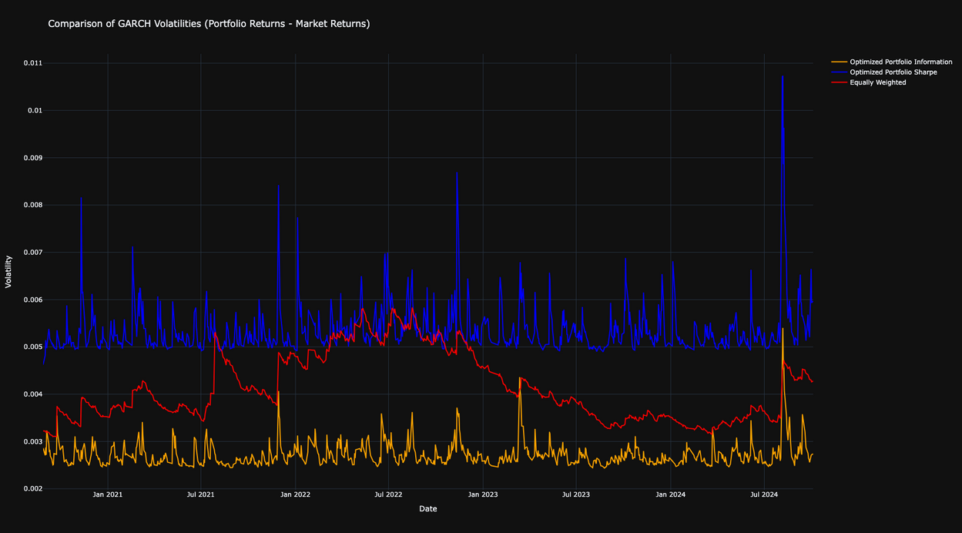
BACKTESTING
AURORA CAPITAL MANAGEMENT
GARCH Volatilities
We applied GARCH models to estimate the volatility of the portfolios and compare it against the benchmark. In this analysis, the GARCH volatility is calculated as the difference between the optimized portfolios and market returns, allowing us to capture the excess volatility introduced by our strategies.
The chart shows that the Information-optimized portfolio (yellow line) consistently maintained the lowest volatility throughout the period, showcasing its effectiveness in managing risk relative to the benchmark. The Sharpe-optimized portfolio (blue line) exhibited higher volatility, indicating more exposure to market shifts, while the Equally weighted portfolio (red line) had volatility between the two but with larger fluctuations than the Information-optimized strategy.
These results confirm the Information Ratio portfolio’s ability to maintain stable, low-volatility performance, making it the most efficient strategy for managing risk over time.
Shar. Opt.
Eq. Weighted
Inf. Opt.
HTTPS://AURORACAPM.CH

Slide 14
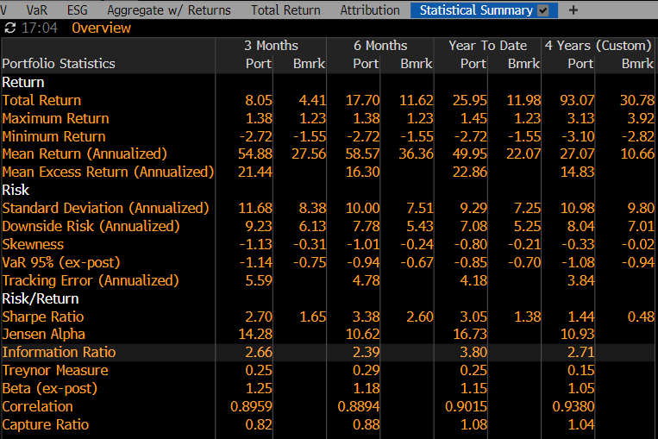
BACKTESTING
AURORA CAPITAL MANAGEMENT
Statistical Summary
We ultimately chose the Information-optimized portfolio for our strategy because it closely tracks the benchmark while maintaining lower volatility. When analyzing the volatility of the difference in returns between the portfolio and the benchmark, the Information-optimized portfolio demonstrated significantly lower volatility compared to the Sharpe-optimized portfolio.
Although the Sharpe Ratio of the Information-optimized portfolio is slightly lower, we prioritized its ability to mirror the benchmark’s returns, as this alignment is crucial for our objectives. The reduced volatility and strong benchmark correlation make the Information-optimized portfolio a more reliable choice, ensuring that it delivers consistent performance in line with the benchmark while effectively managing risk.
HTTPS://AURORACAPM.CH

Slide 15
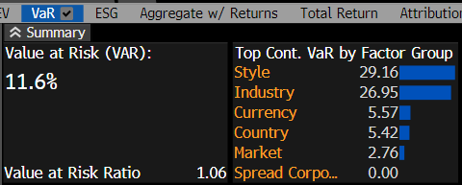
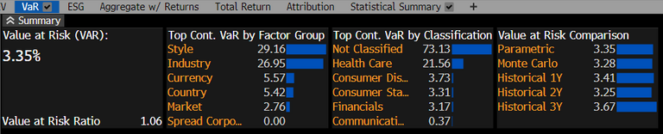
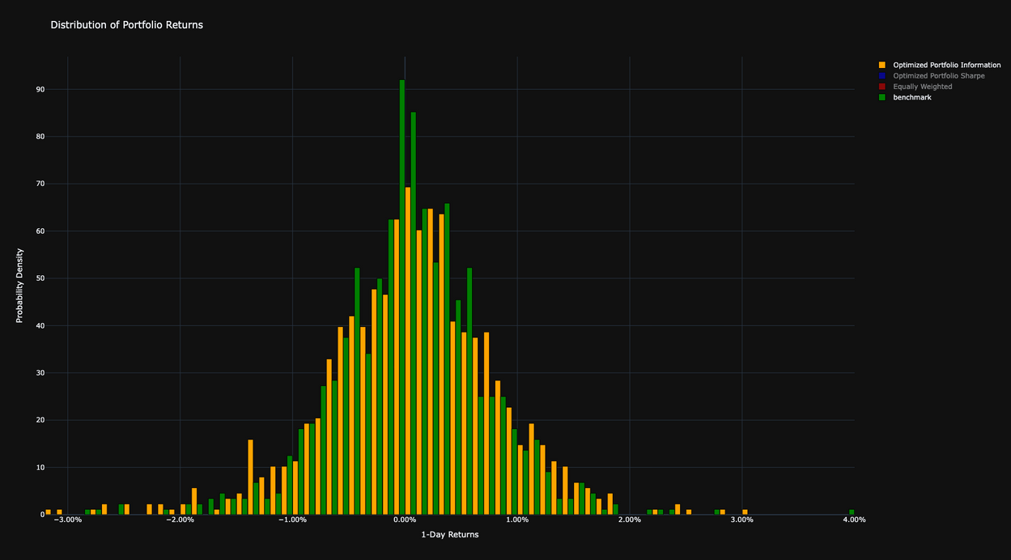
AURORA CAPITAL MANAGEMENT
RISK MANAGEMENT
The portfolio’s Value at Risk (VaR) is 3.35% monthly, while 11.6% annualy, meaning that, with 95% confidence, the portfolio’s maximum expected monthly loss is limited to 3.35%, while 11.6% yearly loss.
This moderate risk level reflects effective risk management, balancing growth potential with downside protection. The VaR Ratio of 1.06 confirms that the portfolio’s risk exposure is aligned with benchmark expectations, ensuring solid risk-adjusted performance.
The benchmark (green) closely resembles a normal distribution, with its peak centered around 0% returns and a skewness close to zero (-0.02), indicating a symmetric distribution. In contrast, the Information-optimized portfolio (orange) has a skewness of -0.33, reflecting a negatively skewed distribution.
This means the portfolio is expected to generate frequent small gains and a few larger losses. This skewness, resulting from our 4-year optimization process, reflects the portfolio’s design to deliver stable returns while managing downside risk effectively.
HTTPS://AURORACAPM.CH

Slide 16
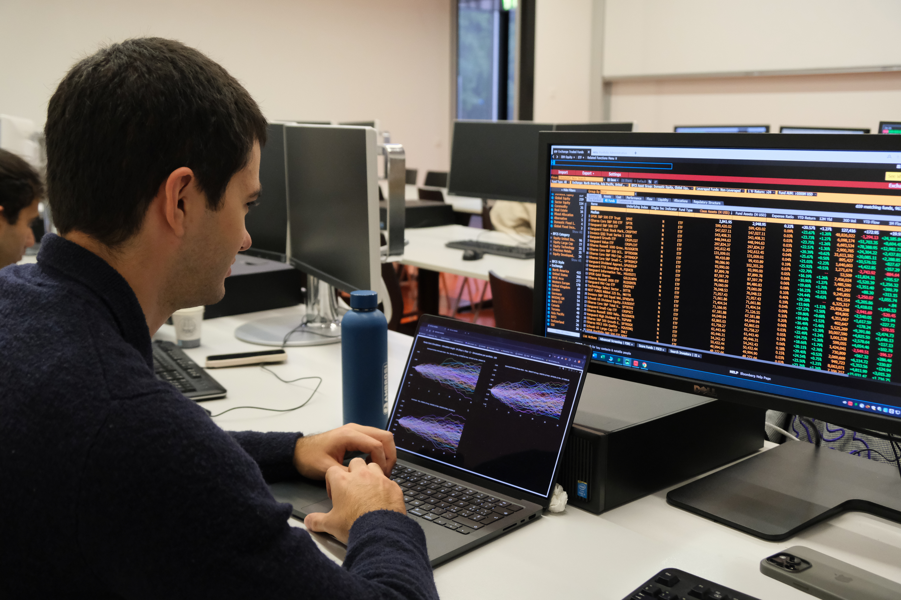
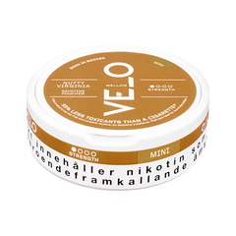
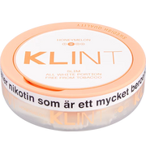
AURORA CAPITAL MANAGEMENT
CONCLUSIONS
Our analysis shows that the Information-optimized portfolio offers the best balance between risk and return compared to the benchmark, maintaining low volatility while closely tracking the benchmark. This portfolio’s stability, as confirmed by the GARCH volatility model, ensures reliable performance even in volatile markets.
The Sharpe-optimized portfolio delivered higher returns but with greater volatility compared to the benchmark, while the equally weighted portfolio lagged in terms of risk-return efficiency. Both optimized portfolios outperformed the benchmark, highlighting the value of strategic optimization in enhancing performance.
With a VaR of 3.35% monthly and 11.6% annually, the Information-optimized portfolio demonstrates effective risk control, designed to manage downside risks while capturing stable returns.
In the face of 2024’s financial challenges, including inflation and geopolitical tensions, our diversified strategy across key sectors like technology and financial services ensures resilience and growth. By focusing on risk management and optimization, we are well-positioned to deliver sustainable, long-term returns.
HTTPS://AURORACAPM.CH

Slide 17

LET'S CONNECT
+41 78 209 41 52
Thank You for Attention
info@auroracapm.ch
HTTPS://AURORACAPM.CH

